Slide 1


Electric Cars
The evolution and Logistics
Riya Savalia

Slide 2

Content
Creator
History
Types of Electric Cars
Why is there a demand for Evs?
Advantages of EVs
Limitations and Challenges
Conclusion

Slide 3
Creator
It was not just one inventor for the make of electric cars, but many inventors’ ideas that brought together the perfect electric vehicle.
In the late 1880s, William Morrison, a Scottish chemist and electricity enthusiast, created the first electric vehicle.
Morrison began making storage batteries and electric motors for carriages, with the intention of making batteries portable and powerful.
In 1887, Morrison equipped a carriage, manufactured by the Des Moines Buggy Company, with his new storage batteries and an electric motor to power the right rear wheel.
Although the vehicle wasn’t the biggest success, it was the first functioning horseless carriage

Slide 4

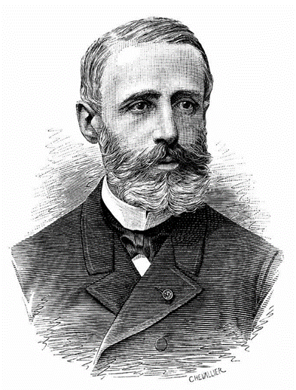

History
Ányos Jedlik (1828)
Thomas Davenport (1834)
William Morrison (1890)
Hungarian engineer and electromagnetic pioneer Designed the first successful electric motor that he put into a small model car.
A Vermont blacksmith who constructed the first American DC electric motor in 1834.
A Scottish chemist who created the first successful electrified wagon in the United States.

Slide 5
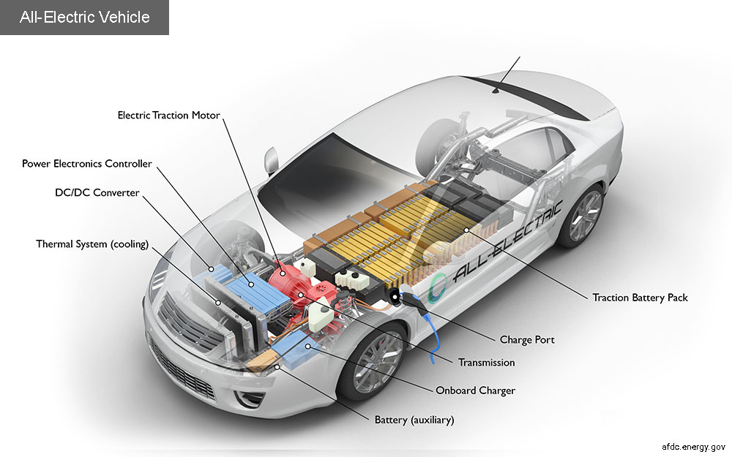
Types of Electric Cars : All Electric
All electric vehicles run mainly by the power the auxiliary battery
Battery supplies power to the electric motor to run
The charging port feature is to the car as a charger is to an iPhone.
Electric Vehicles use both regenerative braking and charging ports.
Regenerative braking is when the momentum of energy used when braking is converted into electrical energy to recharge the battery. (Gasoline powered vehicles will create heat energy using the momentum of the braking).
The DC/DC converter helps regulate the high-voltage of DC power from the traction battery pack to the lower-voltage DC power needed to run vehicle accessories and recharge the auxiliary battery. This can prevent burn outs, etc.

Slide 6
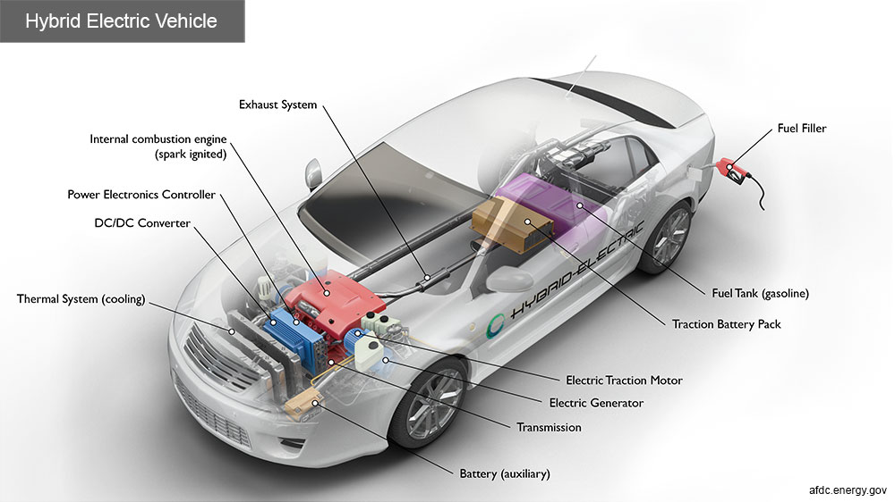
Types of Electric Cars: Hybrid
Hybrid Electric cars are powered by internal combustion engines (driven by other fuel such as gasoline), and a low voltage auxiliary battery.
This vehicle uses regenerative braking completely to recharge the battery, as it has no charging port.
It contains a fuel tank where it can normally be found.
Hybrids will switch between power of electricity and gasoline, requiring a smaller engine. They are known to have great fuel economy.

Slide 7
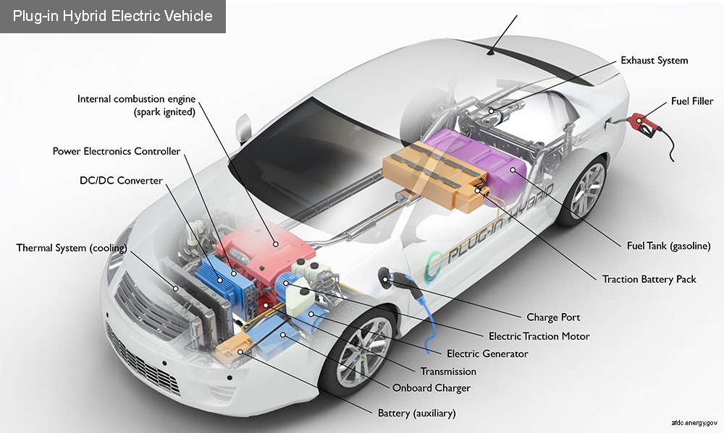
Types of Electric Cars: Hybrid Plug-in
Hybrid plug ins are powered by electricity from a low voltage auxiliary battery and an internal combustion engine powered by another fuel such as gasoline
To recharge the battery, the vehicles allow for a charging port and charge through regenerative braking.
It will function until the battery is almost completely depleted and then switch over to the ICE (internal combustion engine).
Example: 2023 Volvo s60, Toyota RAV4 Prime, 2024 BMW xDrive 330e

Slide 8
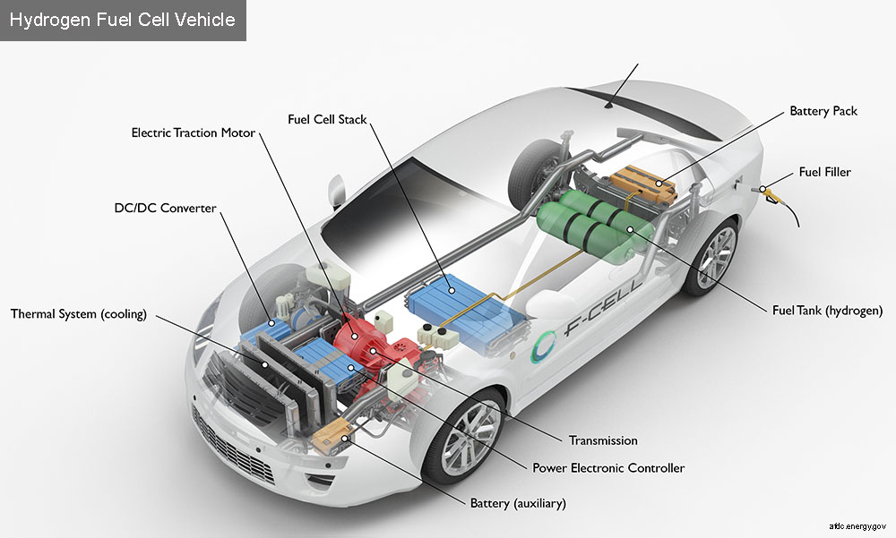
Types of Electric Cars: Fuel Cell Electric
Hydrogen fuel cell electric cars are powered from a battery that uses hydrogen fuel.
The hydrogen is stored in pressurized tanks on the vehicle, and the fuel cell combines the hydrogen with oxygen from the air to produce electricity. The electricity is then transferred to the main battery.
This model does not have a charging port and uses regenerative braking to recharge the battery.
Examples: 2024 Hyundai Nexo compact crossover, and the Toyota Mirai sedan.

Slide 9
Why is there a demand for evs?
1800s- Electric vehicles were originally intended for women
Represented class, and simplicity. Gasoline powered or steam powered vehicles were said to be too complex and loud for women. EVs were also known for their short-range capacity and implicated the idea that women should not traveling far from their families. In a sense, it restricted the ability for women to travel alone. They were considered classy because of their noise reduction compared to petrol cars.
2000s- Companies began to create Diversity, and Generations changed
While the production of electric vehicles continued, consumer became enthusiastic about the different models that were begin produced. Soon celebrities began to flaunt their new Toyota Prius, catching attention of younger generations. Younger generations were also seeking help for climate change, increasing the demand for electric vehicle production.

Slide 10
Limitations and Challenges : Environment
As the demand for electric vehicles grew, the supply for batteries was increasing.
The materials the batteries contain are difficult to find and extract, and the mining process can be polluting. The batteries are made from rare earth elements like lithium, cobalt, nickel, and graphite, which are expensive, and in some cases, toxic and flammable. The mining for lithium has resulted in digging up 20 to 30 tons of earth per year. One battery, contains 25,000 pounds of brine for the lithium, 30,000 pounds of ore for the cobalt, 5,000 pounds of ore for the nickel, and 25,000 pounds of ore for copper.
In addition to batteries, electric vehicles produce the same double the green house gas emissions as a convention fuel powered car, since their bodies are still made up of metals, and plastics.

Slide 11
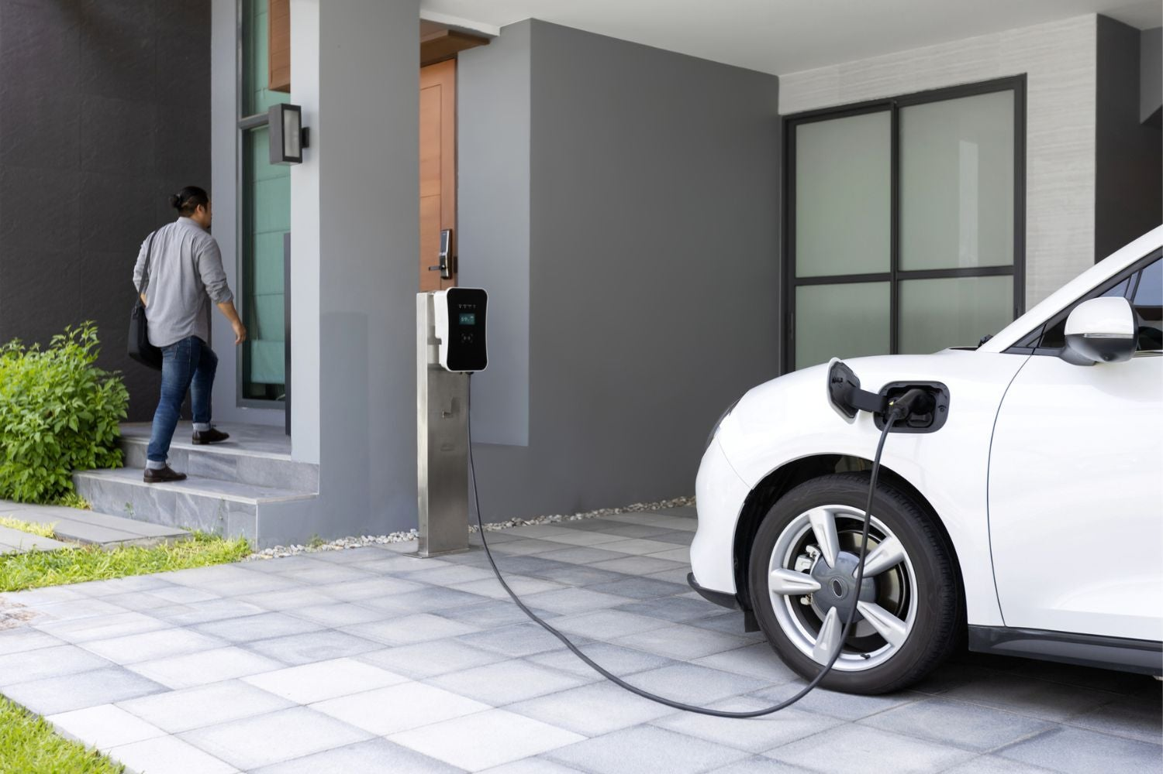
Limitations and Challenges : finance
Through the years of production, electric cars have been priced higher than gasoline powered vehicles during initial purchase. Although, their maintenance is said to be lower (avg.$900) than gasoline powered vehicles (avg.$1200) annually.
Charging ports around the United states have been reported to cost around $1000 to $2500 per public charging port installation. When installing one inside a home after an EV purchase, the cost can be more than $1000 in addition to the money that was just dropped to purchase the vehicles themselves.
Charging Ports also differ in Levels. Level one can take up to an hour for a 10 miles and Level 2 can be about 25 miles per hour. Although Level 2 charges faster, it is more costly and could decrease the battery life of the car if done contiguously.
Due to expense in installations of public charging ports, there seems to be a shortage in availability for charging and an increase in purchase for vehicles. Infrastructure can’t seem to catch up to the new evolution of transportation.

Slide 12
Major Disadvantages
Although they are more powerful and quick than some gasoline powered vehicles, electric vehicles have 100-150 miles less in range compared to a conventional car.
A major drawback comes from charging time of the vehicles whereas gas stations take no longer than 10 minutes to get you back on the road
The cost to replace an electric vehicle battery can range from $6,500 to $20,000, depending on the battery's size, pack, and manufacturer. For example, replacing the battery in a Nissan Leaf costs around $6,200, while a Chevy Bolt costs around $16,000. For a Tesla Model S, the batteries cost between $12,000 and $15,000, and after labor, the total repair cost is around $20,000 to $22,000. For a Tesla Model 3, the replacement cost is around $15,799.27, with the battery alone costing over $13,500 and labor costing $2,299.27.

Slide 13
Conclusion
As the electricity powered revolution begins to empower more companies, electric vehicles seem to be making their way to the top of the popularity board. Since the evolution of electric vehicles is still new, the industries are challenged between environmental factors, consumer demands, and economic success. The models and their efficiency begin to slowly show improvement in the United States, for it has shown that 16% of sales on light-vehicles have become electric.

